Slide 1
Correlation
Chapter 15

Slide 2
A research design reminder
Experimental designs
You directly manipulated the independent variable
Quasi-experimental designs
You examined naturally occurring groups
Correlational designs
You just observed the independent variable

Slide 3
Defining Correlation
Co-variation or co-relation between two variables
These variables change together
Usually scale (interval or ratio) variables
Correlation does NOT mean causation!

Slide 4
Correlation versus Correlation
Correlational designs = research that doesn’t manipulate things because you can’t ethically or don’t want to
You can use all kinds of statistics on these depending on what you types of variables you have
Correlation can be used in any design type with two continuous variables

Slide 5
Correlation Coefficient
A statistic that quantifies a relation between two variables
Tells you two pieces of information:
Direction
Magnitude

Slide 6
Correlation Coefficient
Direction
Can be either positive or negative
Positive: as one variable goes up, the other variable goes up
Negative: as one variable goes up, the other variable goes down

Slide 7
Positive Correlation
Association between variables such that high scores on one variable tend to have high scores on the other variable
A direct relation between the variables

Slide 8
Negative Correlation
Association between variables such that high scores on one variable tend to have low scores on the other variable
An inverse relation between the variables

Slide 9
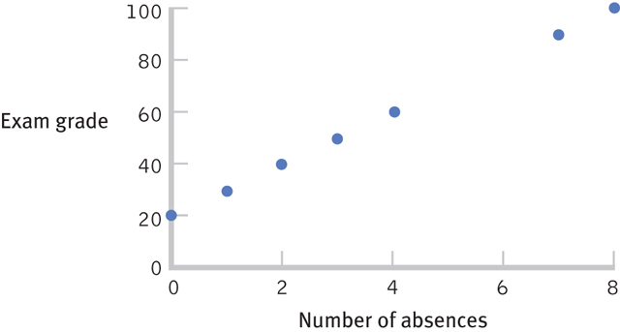
A Perfect Positive Correlation

Slide 10
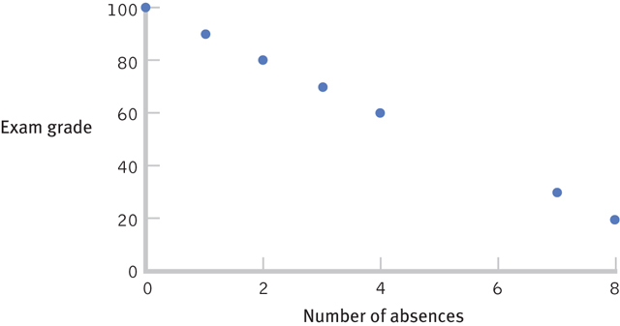
A Perfect Negative Correlation

Slide 11
Correlation Coefficient
Magnitude
Falls between -1.00 and 1.00
The value of the number (not the sign) indicates the strength of the relation

Slide 12
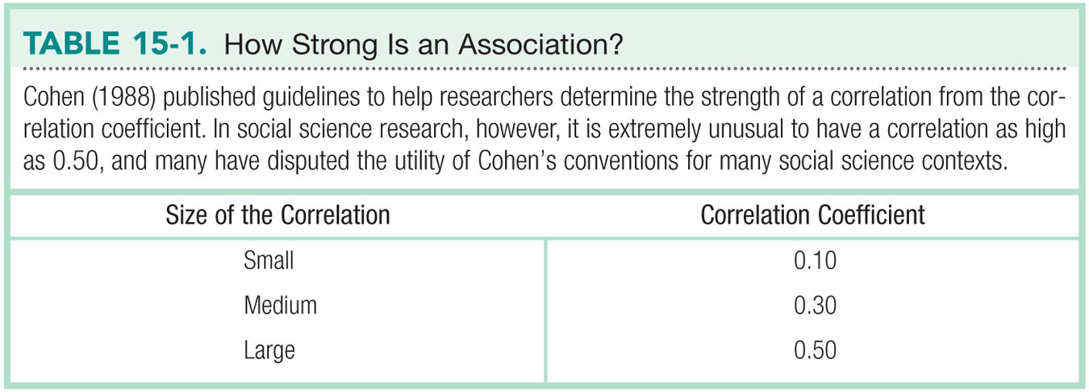

Slide 13
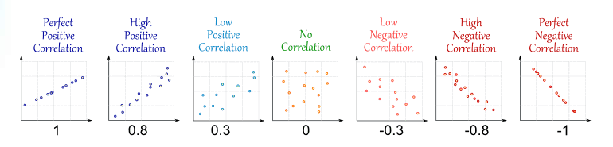
A visual guide

Slide 14
Check Your Learning
Which is stronger?
A correlation of 0.25 or -0.74?

Slide 15
Misleading Correlations
Something to think about
There is a 0.91 correlation between ice cream consumption and drowning deaths.
Does eating ice cream cause drowning?
Does grief cause us to eat more ice cream?

Slide 16
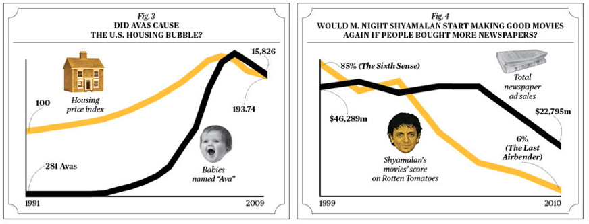
Another silly example

Slide 17
Correlation Overall
Tells us that two variables are related
How they are related (positive, negative)
Strength of relationship (closer to | 1 | is stronger; farther away from 0)
Lots of things can be correlated – must think about what that means

Slide 18
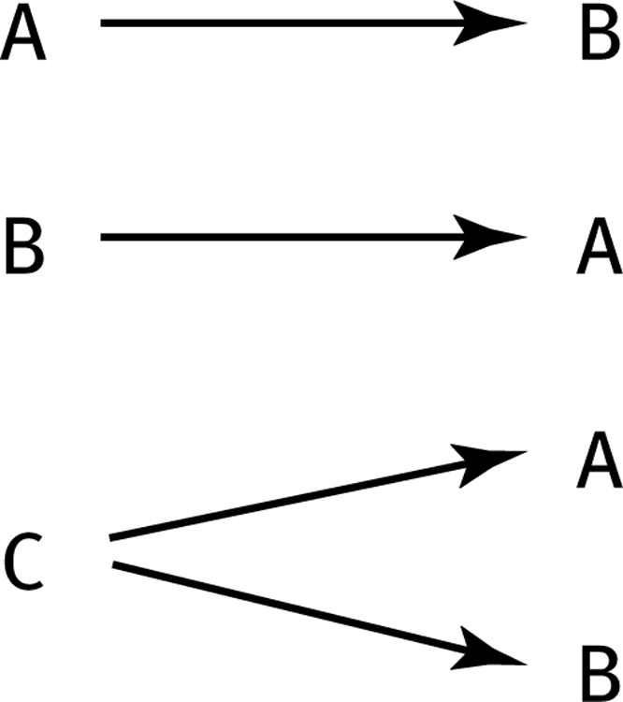
Limitations of Correlation
Correlation is not causation
Invisible third variables
Three Possible Causal Explanations for a Correlation:

Slide 19
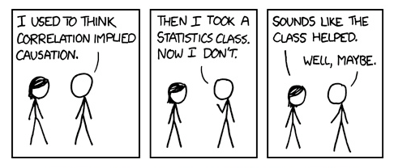
Causation Direction

Slide 20
Limitations of Correlation
Restricted Range
A sample of boys and girls who performed in the top 2% to 3% on standardized tests - a much smaller range than the full population from which the researchers could have drawn their sample

Slide 21
Restricted Range Cont.
If we only look at the older students between the ages of 22 and 25, the strength of this correlation is now far smaller, just 0.05

Slide 22
Limitations of Correlation
The effect of an outlier
One individual who both studies and uses her cell phone more than any other individual in the sample changed the correlation from 0.14, a negative correlation, to 0.39, a much stronger and positive correlation!

Slide 23
The Pearson Correlation Coefficient
A statistic that quantifies a linear relation between two scale variables
Symbolized by the italic letter r when it is a statistic based on sample data
Symbolized by italicized ρ (rho) when it is a population parameter

Slide 24
Correlation Hypothesis Testing
Step 1. Identify the population, distribution, and assumptions
Step 2. State the null and research hypotheses
Step 3. Determine the characteristics of the comparison distribution
Step 4. Determine the critical values
Step 5. Calculate the test statistic
Step 6. Make a decision

Slide 25
Assumptions - Step 1
Random selection?
X and Y at least scale variables?
Linear relationship between variables? (linearity)
Outliers?
Homoscedasticity? (for real this time!)
Each variable must vary approximately the same at each point of the other variable
See scatterplot for UFOs, megaphones, snakes eating dinner.
X and Y are both normal? (normality)

Slide 26
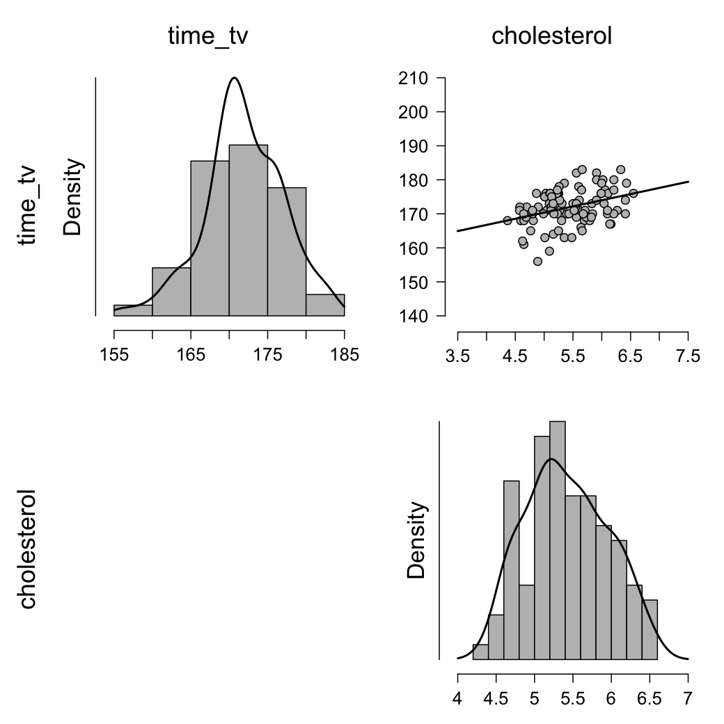
Assumptions - Step 1 (linearity)
Open the data in JASP and make sure the variables are correct
Descriptives → Descriptive Statistics → Move both variables over to the “Variables” box → Plots → Correlation Plot
Look at top right graph
Close to a line? Linear!

Slide 27
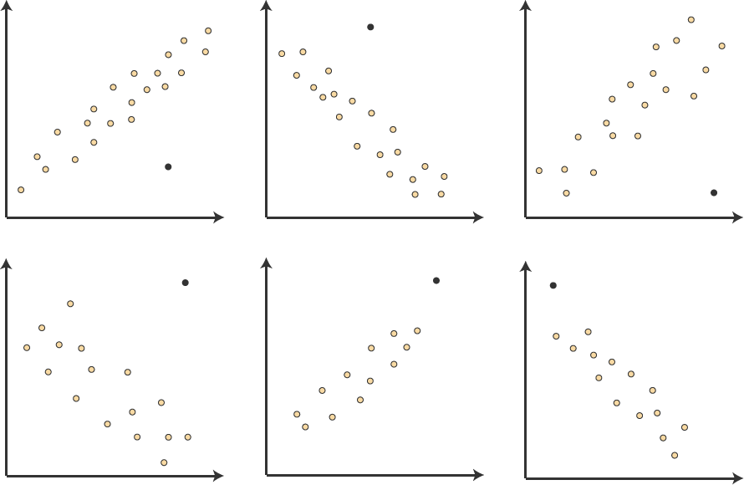
Assumptions - Step 1 (outliers)
Look at the graph in the same graph as linearity
If data points are way off, consider them outliers see examples over here → → →
Our graph:
We don’t have anything that looks like that, so we’re good!

Slide 28
Assumptions - Step 1 (normality)
T-test → One Sample T-Test → Under “Assumptions” select “Normality”
Remember, here we want p > .05
Made it!

Slide 29
Assumptions – Step 1 (homoscedasticity)
How to assess homoscedasticity?
Look at our scatterplot from earlier
Outlier the group of dots
To meet homoscedasticity, needs to the box-like (i.e. the spread across one axis should remain about the same as you move across the other axis)
Ours looks pretty box-like,
so we’re good!

Slide 30
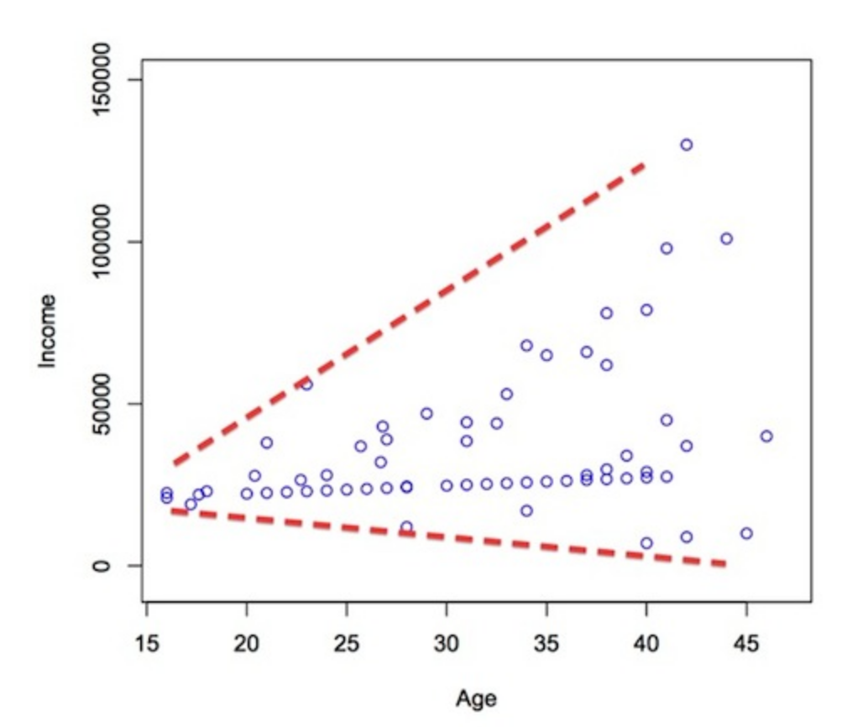
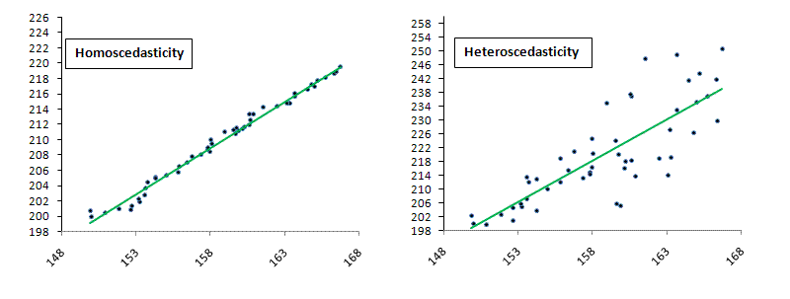
Assumptions – Step 1 (homoscedasticity) cont.
Examples of not meeting homoscedasticity:
If you don’t meet homoscedasticity your data is considered heteroscedastic

Slide 31
Step 2- Sate your hypotheses
Null Hypothesis: no correlation between variable 1 and variable 2
Research Hypothesis: correlation between variable 1 and variable 2
For our example:
Null: r for cholesterol and TV time = 0
No correlation between cholesterol and TV time
Research: r for cholesterol and TV time ≠ 0
Correlation between cholesterol and TV time

Slide 32
Step 3- Find r and df
df = N – 2
To get r we will used JASP
“Regression” → “Correlation Matrix” → move your variables over
Make sure “Pearson’s” is selected → select “Display pairwise table”
Select “Confidence intervals” if needed

Slide 33
Step 4
Find the t _{critical} value
Use the df and p critical to determine t _{critical} using the two-tailed section of the t distribution table

Slide 34
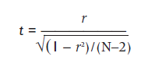
Step 5
Calculate the t _{actual} given your r value
http://vassarstats.net/tabs_r.html

Slide 35
Step 6
If you reject the null:
There is a significant correlation (relationship)
If you fail to reject the null:
There was not a significant correlation (relationship) between the variables in the dataset

Slide 36
Effect Size?
r is often considered an effect size
Most people square it though to r², which is the same as ANOVA effect size
You can also switch r to Cohen’s d, but people are moving away from doing this because d normally is reserved for nominal variables

Slide 37
Confidence Intervals
Involves Fisher’s r to z transformation and is generally pretty yucky
Which means people do not do them unless they are required to

Slide 38
Correlation and Psychometrics
Psychometrics is used in the development of tests and measures
Psychometricians use correlation to examine two important aspects of the development of measures—reliability and validity

Slide 39

Reliability
A reliable measure is one that is consistent
Example types of reliability:
Test-retest reliability
Split-half reliability
Cronbach’s alpha (aka coefficient alpha)
Want to be bigger than .80

Slide 40
Validity
A valid measure is one that measures what it was designed or intended to measure
Correlation is used to calculate validity, often by correlating a new measure with existing measures known to assess the variable of interest

Slide 41

Validity
Correlation can also be used to establish the validity of a personality test
Establishing validity is usually much more difficult than establishing reliability
Buzzfeed!

Slide 42
Partial Correlation
A technique that quantifies the degree of association between two variables after statistically removing the association of a third variable with both of those two variables
Allows us to quantify the relation between two variables, controlling for the correlation of each of these variables with a third related variable

Slide 43
Partial Correlation
We can assess the correlation between number of absences and exam grade, over and above the correlation of percentage of completed homework assignments with these variables

